Slide 1
Working remotely or from home? How to reduce exposure to ergonomic risk factors Kelly ott, CSP, CHSP Ergonomist State of Ohio, Bureau of Workers’ compensation - BWC

Slide 2
Transition
Many people are now working from home and may have had to move quickly to this “new office” environment.
Children may now being completing school from home.
The home office may have some differences in:
Types of Interruptions
Office Furniture
Lighting

Slide 3
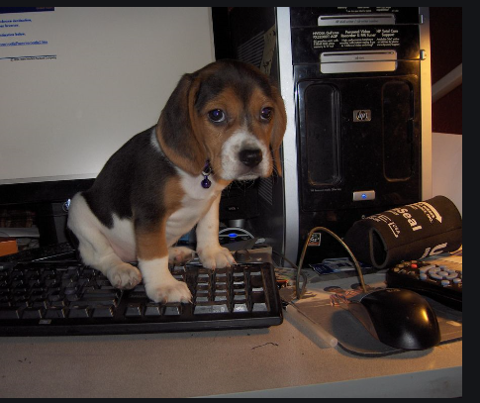
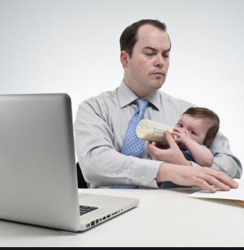
Home office interruptions

Slide 4
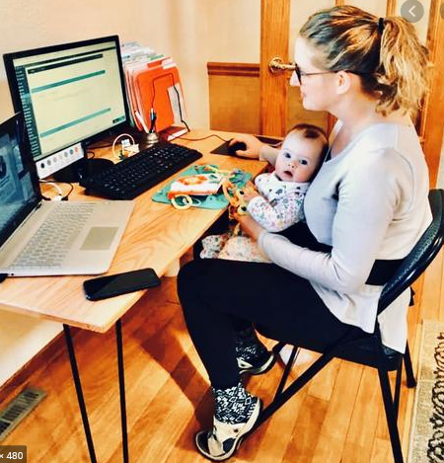
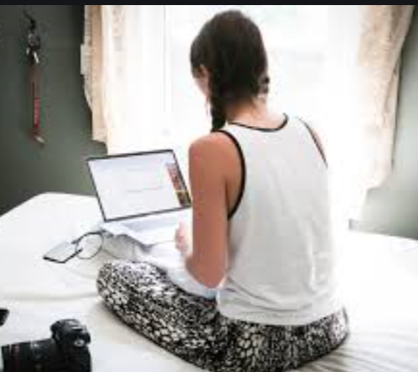
New office furniture

Slide 5
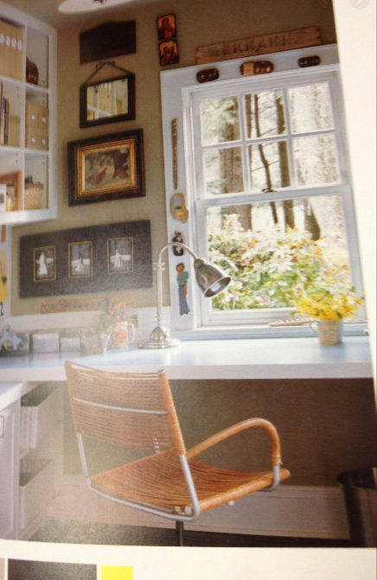
Lighting issues

Slide 6
Lighting during virtual meetings

Slide 7
What are some of the ergonomic risks related to office work especially at home
Awkward postures
Wrist, neck, lower back, shoulder
Poor or too much lighting. Eye strain from looking at a screen or laptop screen for extended time frames
REPETITION : Lack of movement – static positions
Sitting or standing for an extended time
Pain, stiffness, musculoskeletal injury

Slide 8
Injuries of Concern
Musculoskeletal Disorder (MSD)
An injury to the body’s soft tissues (e.g., muscles, tendons, ligaments) caused, over time, by work activities
Strain
An injury to a muscle, often caused by overuse
Sprain
An injury that occurs to ligaments caused by a sudden over-tearing

Slide 9
Awkward Postures
Hand & Wrist
Notes:
Notes:

Slide 10
Ergonomic risk - Wrist
Awkward postures
Avoid allowing the wrist to rest on any hard surface
Avoid the wrist being bent when using the keyboard

Slide 11
Goal is to keep a Neutral posture

Slide 12
Ergonomic risk : Awkward neck and shoulder posture

Slide 13
Awkward postures - neck

Slide 14
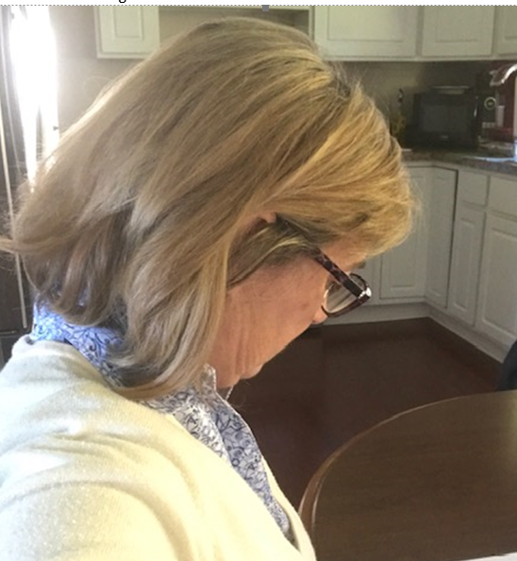
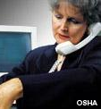
Awkward neck postures

Slide 15
Text Neck

Slide 16
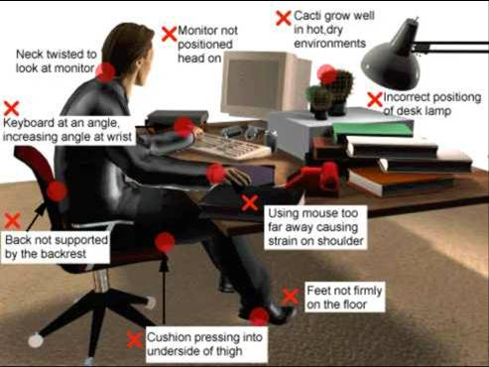

Slide 17
POSTURE (think neutral!)
Ears above shoulders, head facing forward
Upper back slightly reclined or vertical, shoulders relaxed
Elbows comfortably at sides
Forearms parallel*, wrists neutral
Low back slightly arched
Thighs ~horizontal
Feet flat on floor/foot rest
Notes:
Notes:

Slide 18
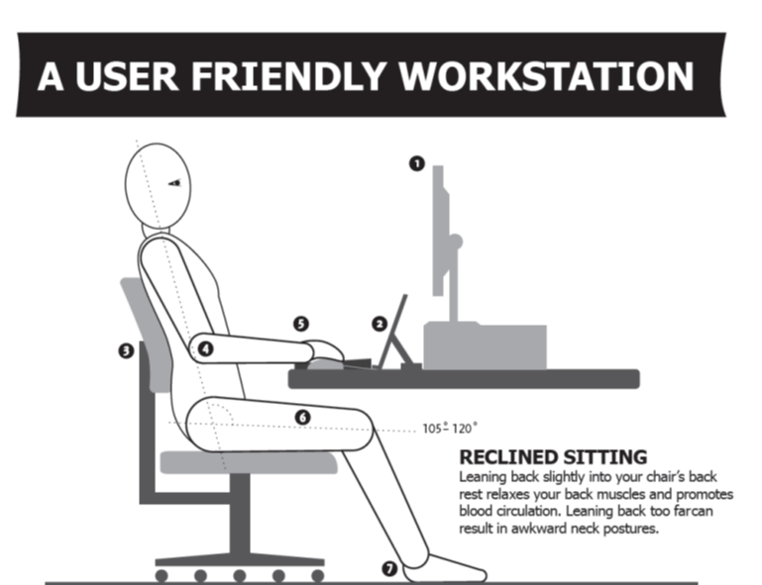
Sitting in neutral postures

Slide 19
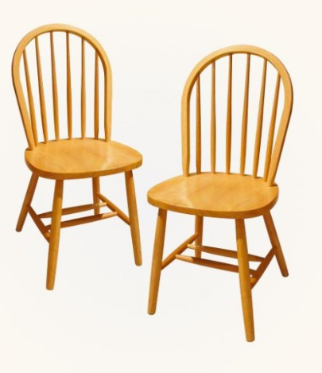
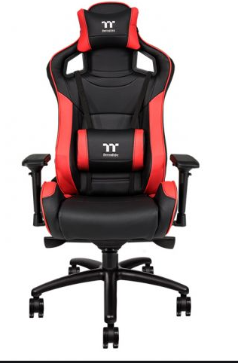
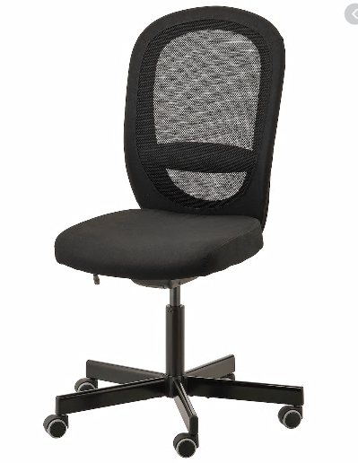
The chair

Slide 20
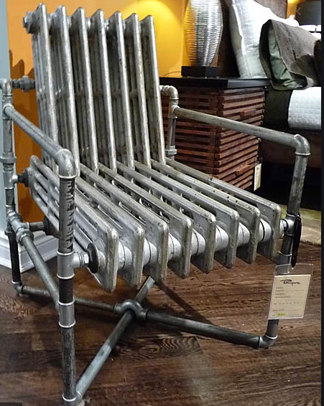
Chairs???? Uncomfortable and not ergonomically friendly

Slide 21
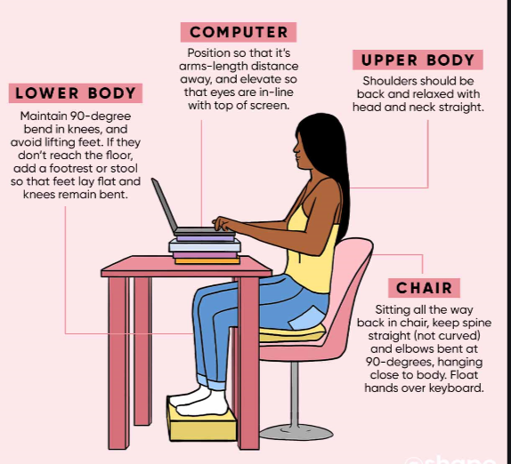
Home office tips
Place a cushion on the bottom of your chair
Use books such as a telephone book, boxes – repurpose those Amazon boxes or game box
Use books to lift a laptop, mouse or keyboard

Slide 22
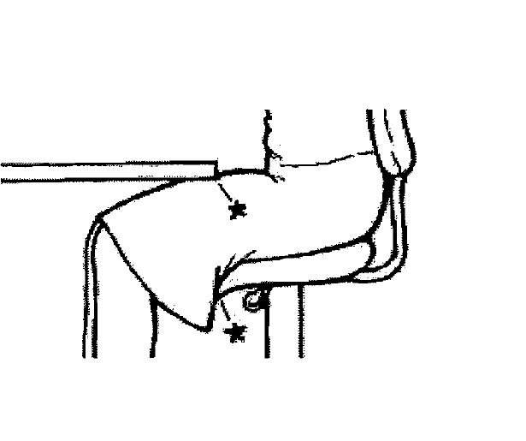

Slide 23
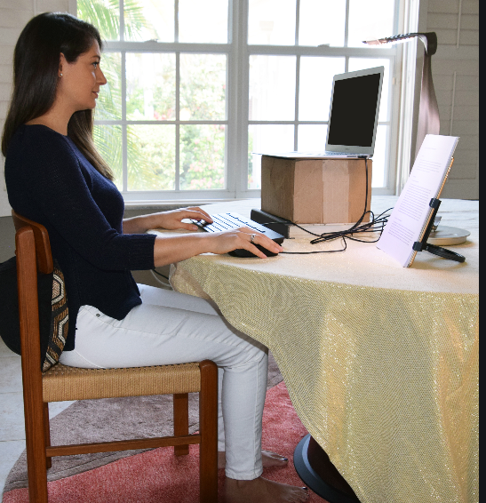
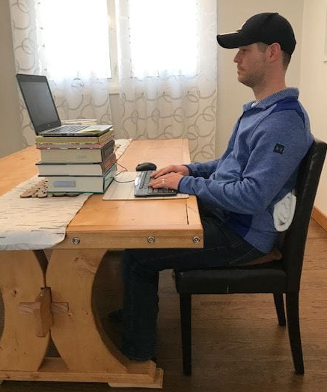
Tips For height adjustments and support

Slide 24
Ergonomic risk – Repeated static posture
Sitting or standing for an extended time has been associated with:
Increasing the potential for musculoskeletal injuries – neck pain, shoulder pain, lower back pain
Increasing the potential for high blood pressure, reducing metabolic rate, lower or reduced blood flow
Standing
Stand on an ergonomic mat
Try marching in place occasionally. Do leg lifts to the side – hold on to something for stability
Sit down to relieve pressure on the legs
It is IMPORTANT TO MOVE

Slide 25
Suggestions to keep moving
If sitting: get up at least once per hour to walk or move for at least 5 minutes. Moving every 20 – 30 minutes is even better
Set a timer on your smart phone to make a sound and remind you to move
Set a banner on your computer screen as a reminder
If you are sitting during virtual meetings – try standing, walking with your smart phone if available
Lifting weights or using a stretch band during virtual meetings
Change postures frequently
Stretch gently

Slide 26
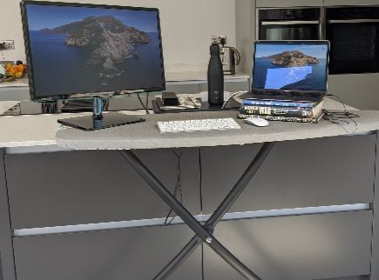
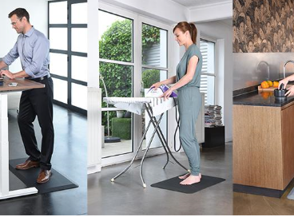
Options for standing in the home office
You may use an ironing board as an
adjustable height surface
Recommend standing on a soft mat
Notes:
https://www.google.com/search?q=home+office+standing+on+ergo+mat+with+ironing+board&tbm=isch&ved=2ahUKEwibv5eYs4TsAhWBZ60KHb5iDLEQ2-cCegQIABAA&oq=home+office+standing+on+ergo+mat+with+ironing+board&gs_lcp=CgNpbWcQA1DnsxlY2NMZYNfaGWgAcAB4AIAB4gKIAfQQkgEIMTAuOC4wLjGYAQCgAQGqAQtnd3Mtd2l6LWltZ8ABAQ&sclient=img&ei=7e5tX9uUOIHPtQW-xbGICw&bih=1067&biw=1920&hl=en#imgrc=q-2EVVXclg7taM

Slide 27
Lighting risks
Glare on the screen causing eye strain
Blue light exposure from staring at the computer screen
Reduction in the ability to read print on paper or the screen
Too much lighter has been known to trigger migraines or headaches
Too little lighting impacts eye strain

Slide 28
lighting

Slide 29
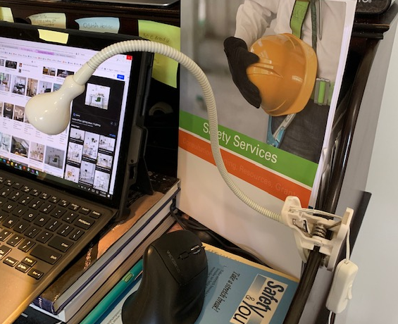
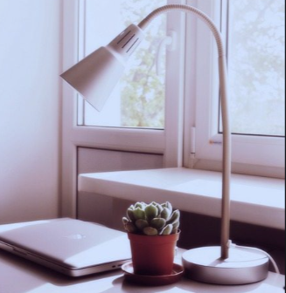
Suggestions for lighting
Task lighting that is adjustable helps provide light on paper or documents or the keyboard

Slide 30
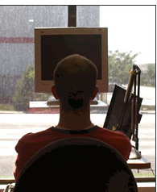
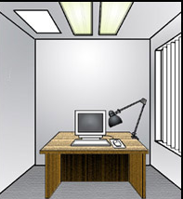
Placement of the monitor AND WINDOWS
No – window behind
No - window in Front
YES -
WINDOW TO THE SIDE

Slide 31
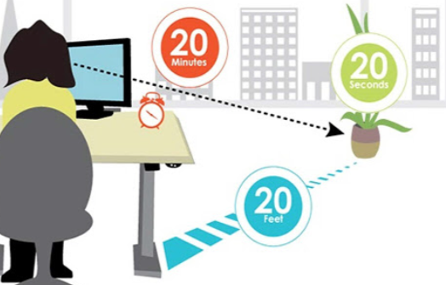
Eye Strain risk - looking up close
Recommend the 20,20,20 rule
Look up and away from the computer screen
Every 20 minutes,
Look away or at a distance of 20 feet,
Look away from the screen for at least 20 seconds
Notes:
https://www.staples.com/Safco-Zenergy-Fabric-Ball-Office-Chair-Armless-Pink-4750PI/product_1064783?cid=PS:GooglePLAs:1064783&ci_src=17588969&ci_sku=1064783&KPID=1064783&gclid=EAIaIQobChMI9-TzpO__6wIVPvzjBx24ZQn0EAQYBiABEgIfevD_BwE

Slide 32
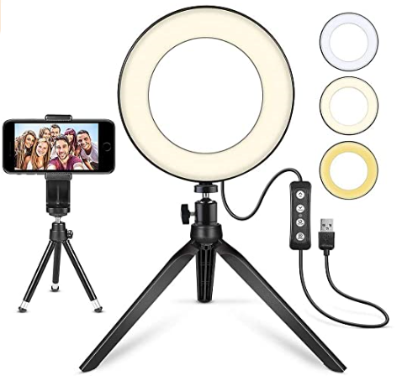
THOSE VIRTUAL MEETINGS AND LIGHTING
Again no open window light behind you You may want to consider using a circle light
Tip: Using your smart phone turn the camera onto yourself. Walk around the room until you find a location where the lighting gives a nice look. Use this area for those virtual meetings. Double check again before the meeting.
Watch the camera angle on the computer you are using for virtual meetings. Double chin showing???

Slide 33
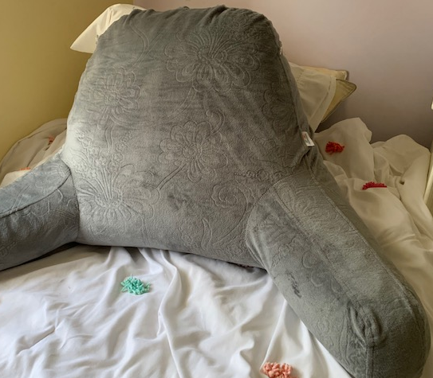
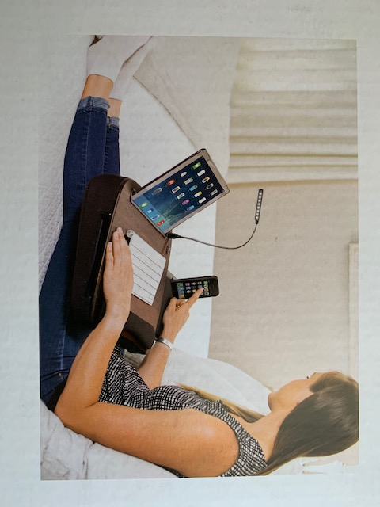
Kids - Adjusting the work area

Slide 34
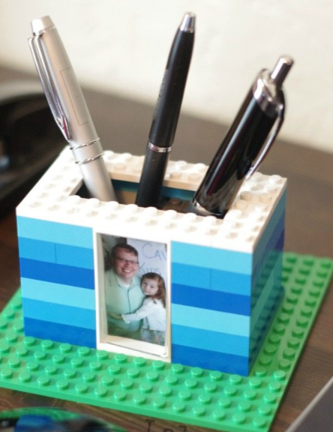
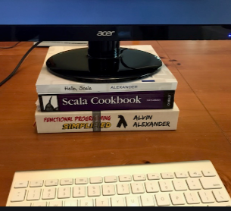
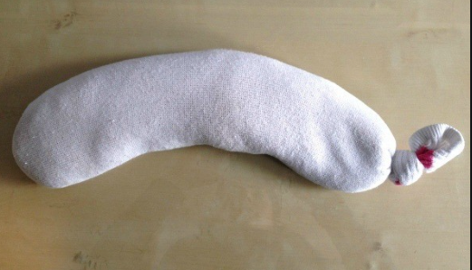
DIY OFFICE HACKS
Sock with rice – possible wrist rest or heat for aproximately 1 minute in the microwave – place on neck or shoulder

Slide 35
Tips for setting a home office that is ergonomically friendly And with stuff you may already have on hand.
https://www.youtube.com/watch?v=tIMYheWrrtc

Slide 36
REview
Did you learn about ergonomic risks in the home environment? If so what risks will you look for –
Please answer in the chat forum.

Slide 37
Review
Did you learn any new solutions?
Answer in the chat forum

Slide 38
review
Will you try any solutions?
Answer in the chat forum

Slide 39
Would you like further information about ergonomics or our bwc safety consulting services?
Kelly Ott, CSP, CHSP
Ohio Bureau of Workers’ Compensation
kelly.ott.1@bwc.state.oh.us
330-323-0030

