Slide 1
The McKinley Chapter
AMERICAN SOCIETY OF
SAFETY PROFESSIONALS

Slide 2
ASSP MEMBERSHIP: CAN BENEFIT YOUR SAFETY PERFORMANCE AND YOUR CAREER

Slide 3
FORMERLY
Founded in 1911, the American Society of Safety Professionals was known as the American Society of Safety Engineers until June 2018.

Slide 4
100th Anniversary in 2011.
Oldest and largest professional society protecting people, property and the environment.
Headquarters: Park Ridge, IL
Membership: 37,000 safety, health and environmental professionals across the globe
Territory: in 72 countries, 8 US regions with150 chapters,.

Slide 5
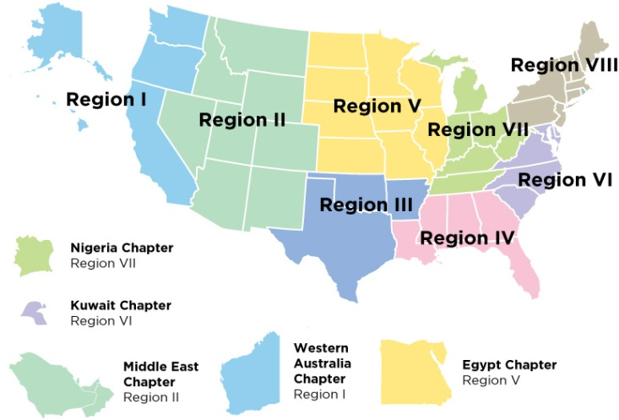
Region and Area Professional Development Conferences
Region VII
Ohio
Michigan
Indiana
Kentucky
Tennessee
West Virginia

Slide 6
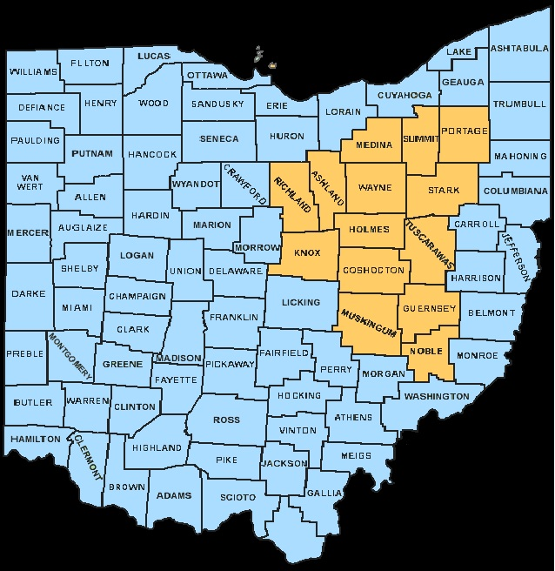
Includes 14 Ohio Counties
Ashland
Coshocton
Guernsey
Holms
Knox
Medina
Muskingum
Noble
Portage
Richland
Stark
Summit
Tuscarawas
Wayne

Slide 7
ASSP is a global member-driven association providing representation, promotion and support for those engaged in the profession and/or the practice of SH&E in their efforts to protect people, property and the environment

Slide 8
ASSP Vision
be a global champion of the
SH&E professional
…a global leader of the
profession
…a premier resource

Slide 9
ASSP maintains the highest level of professional ethics.
ASSP values the protection of people, property, the environment, and the profession.
ASSP provides the highest quality of service for members and customers.

Slide 10
Your Career and Your Company Benefits
Your personal career knowledge and status are higher with ASSP membership. Access to a network of Safety Professionals across the country.
Your company and you benefit by getting advanced information, knowledge and training to be more effective in preventing injuries and illnesses which helps your company’s bottom line and your professional status.

Slide 11
Member Benefits that can
Enhance Your Career and Safety Performance

Slide 12
PROFESSIONAL SAFETY
Monthly Magazine
Feature Articles
Rules and Regs
Industry Notes
Standards
Safety/Business book reviews
Best Practices/Articles
Over 120 SH&E events listed
New Product innovations

Slide 13
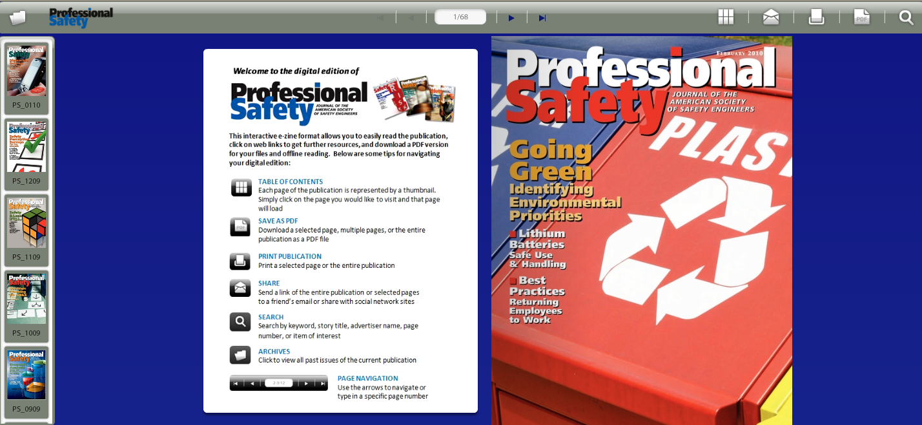
Hard Copy and/or
E-Delivery of Professional Safety Journal

Slide 14
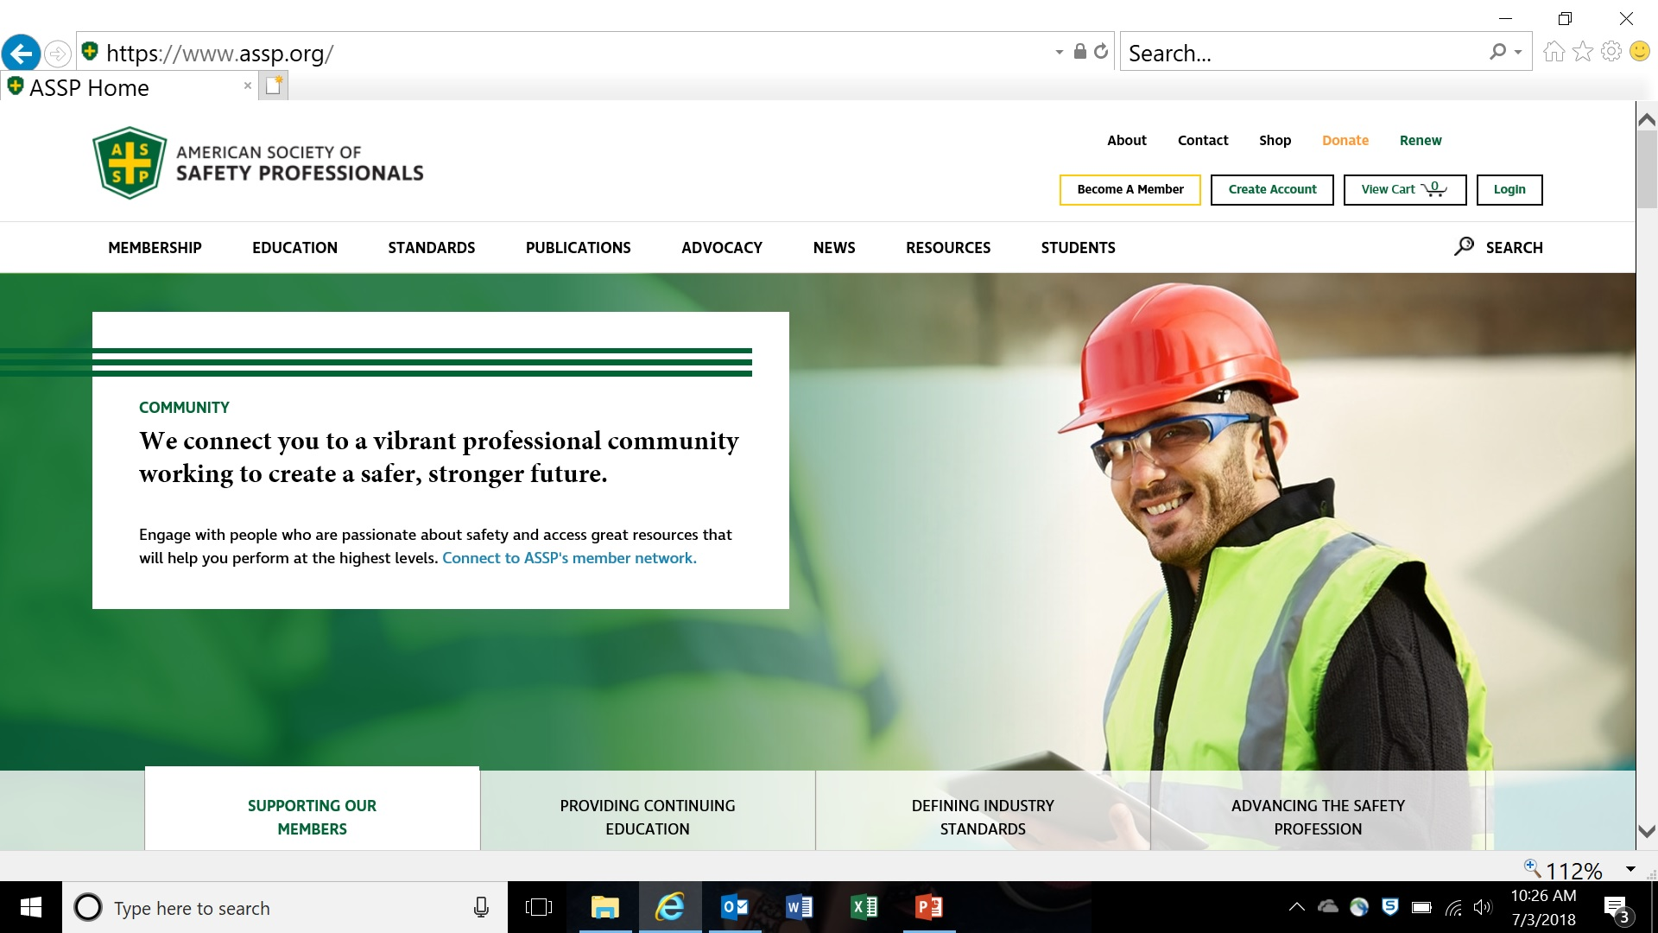
ASSP.ORG
Web Links-

Slide 15
Web Links-
RegionVII.ASSP.ORG

Slide 16
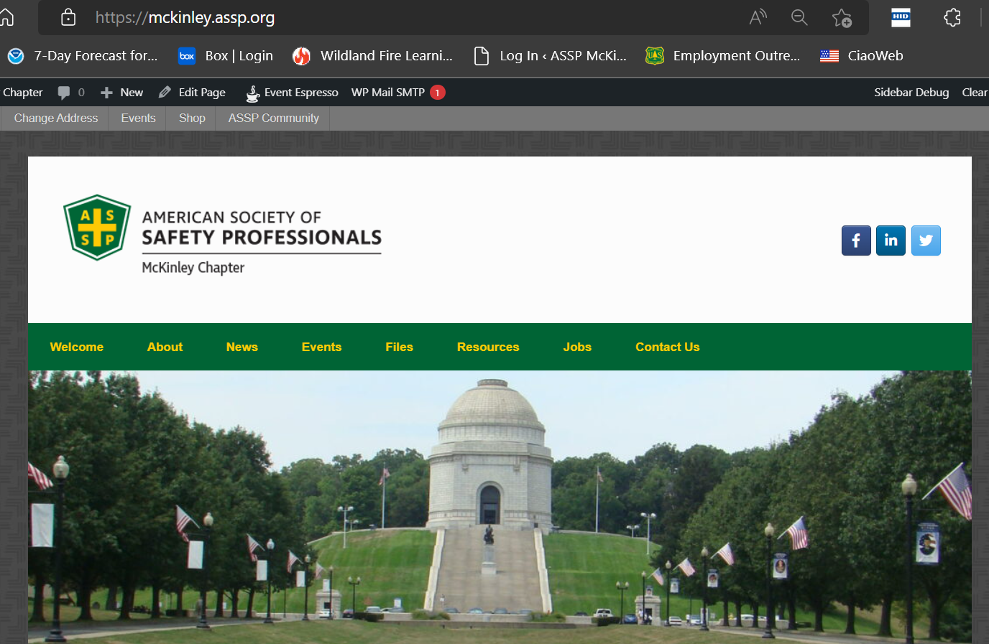
Web Link-
mckinley.assp.org

Slide 17
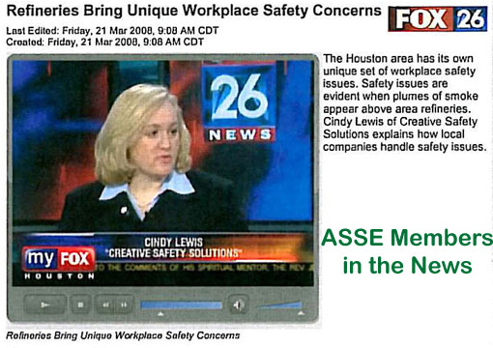
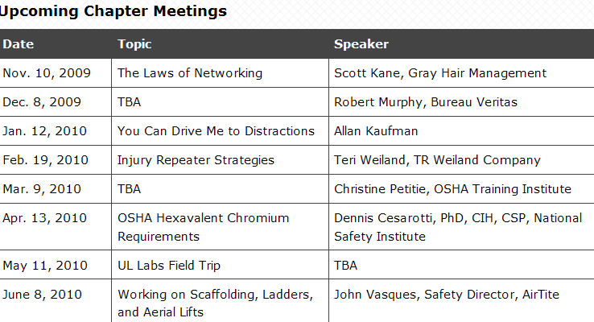
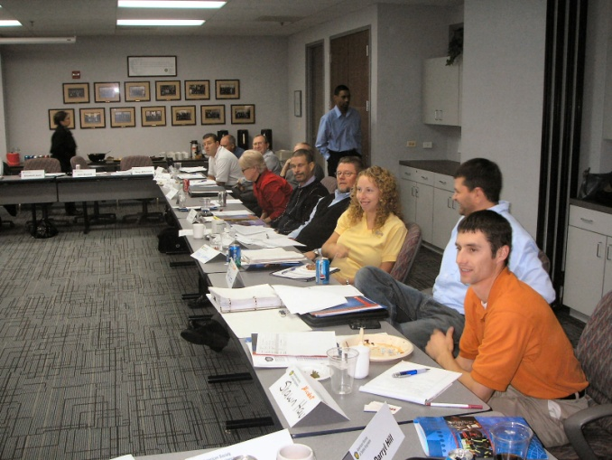
Chapters
Technical meetings, networking, local PDCs
Newsletter
Media relations

Slide 18
Professional Development Thru ASSP
Identify the key issues and challenges facing
safety professionals
Deliver programs that build the skills and
knowledge for SH&E professionals to succeed
Certification Preparation Workshops
ASP, CSP, OHST, CHST
Earn IACET CEU’s to maintain certifications

Slide 19
The McKinley Chapter
AMERICAN SOCIETY OF
SAFETY PROFESSIONALS

